Slide 1


Studies on Human Behaviour Course Introduction. Technical bits.
Mattia Zeni
University of Trento

Slide 2

About me
Background in Telecommunications Engineering
Switched to Computer Science for a PhD on Human Behaviour
Researcher in university and a couple of research institutions
Switched to industry as a researcher
Data scientist for a multinational company
Working on a data collection infrastructure and how to extract insights from big data to take better business decisions
There is a common element in this: data science

Slide 3
Technical bits
My part of the course is practical, with tangible examples and real data to solve real problems
I would like to teach you how I deal with a data science problem in my day-to-day job
I will introduce some of the tools and best practices I have learned
Hopefully, all this will help you in your first data science job
NB: considering the mixed background of the class, I won’t do hardcore programming, just basic stuff that everyone can handle.

Slide 4
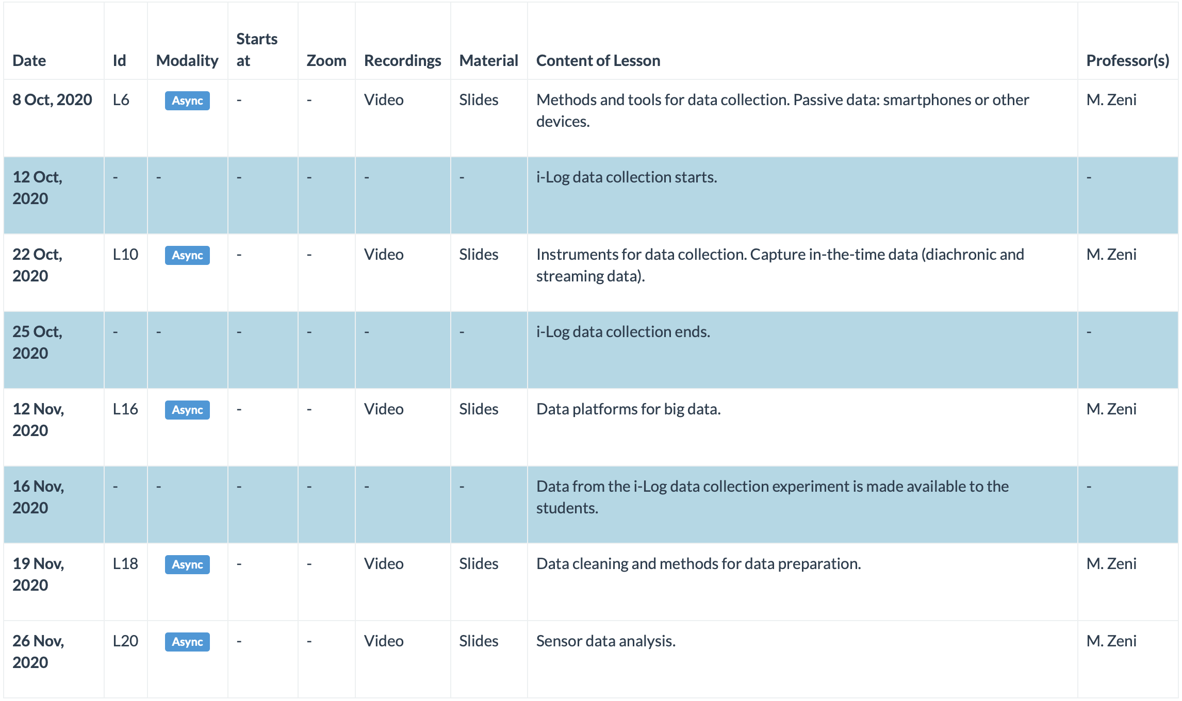
Calendar

Slide 5
Lesson 6
Methods and tools for data collection. Passive data: smartphones or other devices.
Types of data for studying human behaviour
Which types of sensor data
Where to collect data from?
Laboratory setting vs in the wild concept
How to install the i-Log application

Slide 6
Lesson 10
Instruments for data collection. Capture in-the-time data (diachronic and streaming data).
The i-Log application: introduction
Sensor data
Time diaries
Application architecture
Performance trade-offs
Generated data
How to install and use it

Slide 7
Lesson 16
Data platforms for big data.
The StreamBase system:
What is it?
How it works?
Components
Technologies
Data model
Lessons learned
Introduction to some tools: Apache Cassandra, Apache Spark, etc

Slide 8
Lesson 18
Data cleaning and methods for data preparation
Good data vs bad data
Why not all data is good for our purpose
Data cleaning: what is it?
Data cleaning approaches
Data preparation
Etl pipelines

Slide 9
Lesson 20
Sensor data analysis.
How to answer to a data analysis request?
Hypothesis
Understand what to do
Process the data
Generate the results
Generate the final report
Example: SmartUnitn location data

Slide 10
i-Log data collection
12 – 25 October data collection
You will be asked to install on your mobile devices a mobile application and collect data about yourself
You will use such (real) data in your final examination!
PS: Not mandatory to use it, but if you satisfy the requirement please do it for your colleagues if not for you!
i-Log requirements
Android >= 6.0
Some free disk space (0-5gb)
Wi-Fi connection at home (unless you come to the University)
16 November data is made available to you

